Slide 1
Two-Wheeler and Three-Wheeler EV Charging Solutions
EV Infrastructure

Slide 2
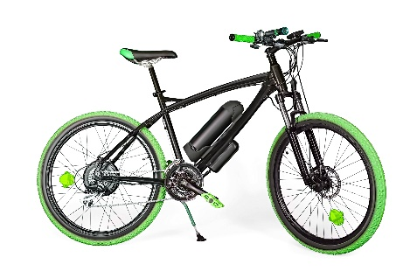
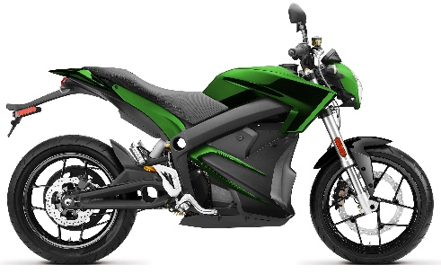
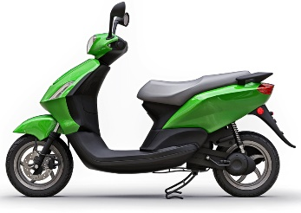
By fulfilling zero-emission mandates, electric two-wheelers and three-wheelers help improve air quality
Battery Capacity
500 Wh
1,000 Wh
3,000 Wh
5,000 Wh
7,000 Wh
10,000 Wh
Electric Bike (250−900 W)
Electric Motorcycle
Asia: (3−25 kW)
RoW*: (20−200 kW)
Electric Utility Vehicle
(5−20 kW)
e-Kick Scooter (600−1.5 kW)
Electric Three-Wheeler
(2−8 kW)
Electric Two-Wheeler
(400 W−4 kW)
Battery Voltage Range 24–96 V
* Rest of the World

Slide 3
Electric two-wheelers and three-wheelers market trends and drivers
Market trends and drivers
The global electric two-wheeler and three-wheeler market is projected to grow from 1.05M units in 2021 to 19.11M units by 2031, at a CAGR of ~34%
The global electric two-wheelers and three-wheelers lithium-ion battery pack market has shown double-digit growth. The limited life cycle and usable capacity are likely to shift the focus from lead acid batteries to lithium-ion batteries
Li-ion batteries are lightweight, which helps maintain the energy to weight ratio of the vehicle
48 V battery packs comprise the largest share; higher-end models (>20 kW) also come with 60−96 V battery pack
Asia Pacific is expected to be the largest market. China spent approximately $2.4 billion by 2020 to improve its charging facility infrastructure
The Indian government has undertaken initiatives such as FAME-II, offering subsidies and tax exemptions to encourage buyers to change from ICE bikes to electric two-wheelers and three-wheelers to reduce Carbon emission
27 European countries have imposed taxes on carbon dioxide emissions related to vehicles
Rapid growth of electric two-wheelers and three-wheelers
*
Source: CEEW, Littelfuse estimates (Does not include Kick Scooter, Electric Bike, and China electric two-wheeler forecast)
* Rest of the World

Slide 4
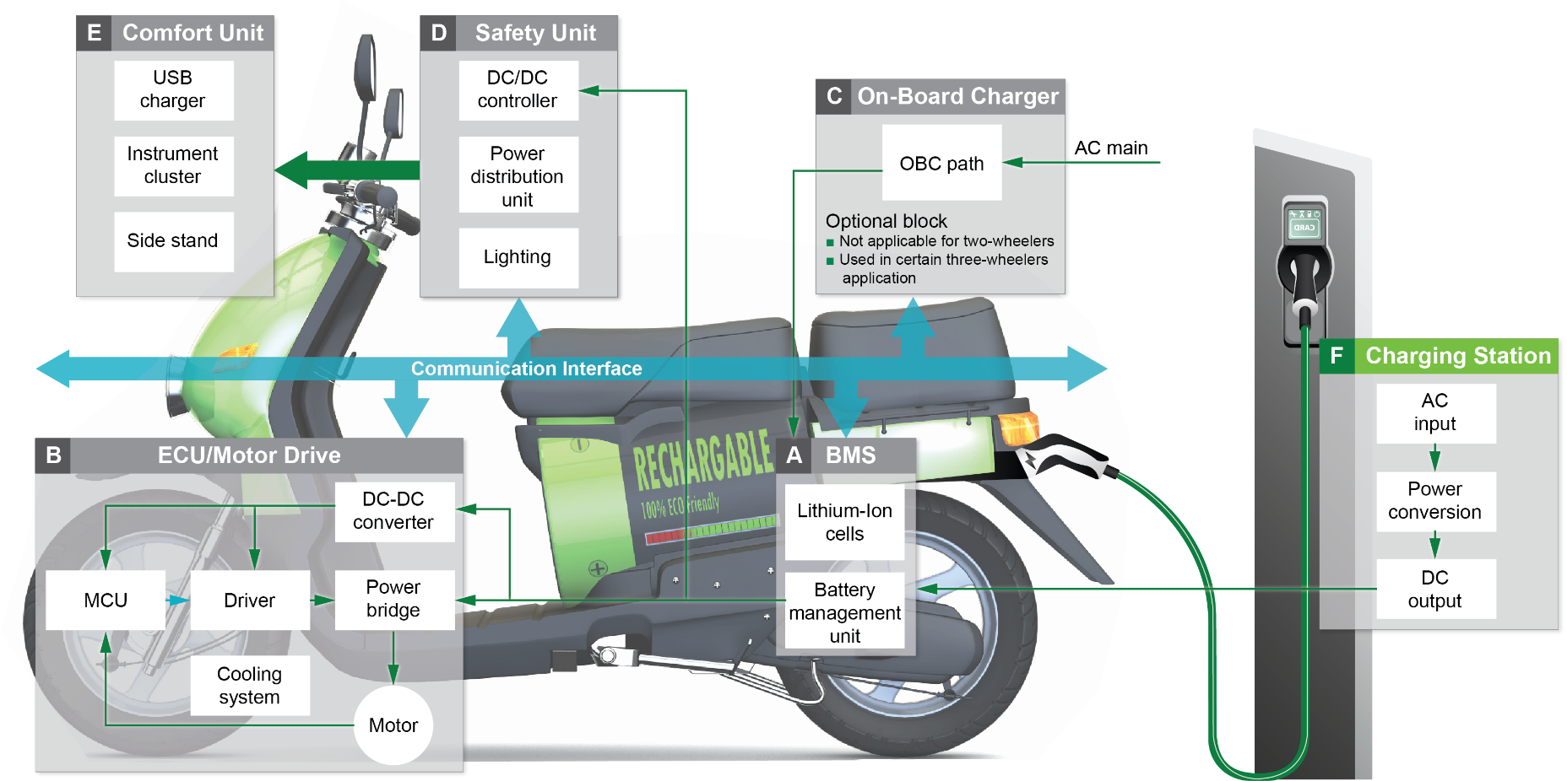
Electric two-wheelers and three-wheelers system architecture

Slide 5
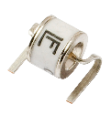
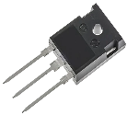
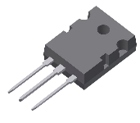
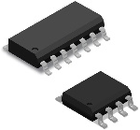
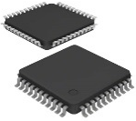
Two-wheelers and three-wheelers charging application block diagram
F
2
1
3
Input
protection
Input rectification
+
Power Factor Control (PFC)
Primary
bridge
Output
rectifier
Output
protection
Diode Rectifier + Boost PFC Converter
OR
Bridgeless PFC Converter
Phase shift Half or
Full Bridge
Resonant LLC topology
Passive rectification
Active rectification
4
Control board
Fuse
MOV + GDT
Rectifier Bridge /
Diode
MOSFET
Gate Driver
Fuse
MCU
1
Input
protection
2
Power
conversion
3
Output
protection
4
Control board

Slide 6
Si Solution 1Ф: <1 kW−V_{OUT} <120 VDC w/PFC
F
Click on the product series in the table below for more info
 | Technology | Series
I | Fuse | 216, 215, 314
II | MOV + GDT | TMOV, Xtreme
 | GDT | CG2, CG3
III | Rectifier Bridge | FBO40-12N
IV | MOSFET | X2-Class, X3-Class
 | Gate Driver | IX4340, IXD60x
 | SiC Diode | LSIC2SD065
 | Power MOSFET with HiPerDyn™ FRED | FMD 47-06KC5
V | MOSFET | X2-Class, X3-Class, FMD 47-06KC5
 | Gate Driver | IX4340, IXD60x
VI | Diode | DSEK 60, DSEP, DPG
VII | Fuse | 688, midi-70, CNN, CNNE, BF1 58
VIII | MCU | Z8F3224
VI
VII
EMI
Filter
II
III
IV
V
Single phase
ºt
I
Legend:
Power
Data
VIII
MCU

Slide 7
Features and benefits of Littelfuse components
F
Click on the product series in the table below for more info
 | Technology | Function in application | Product Series | Benefits | Features
I | Fuse | Protects and isolate subunit in case of short circuit | 216, 215, 314 | Reduces customer qualification time by complying with third-party safety standards, such as UL/IEC | Compliance with third-party safety standards, such as UL/IEC
II | MOV + GDT | Protects from temporary over voltage event and transient surges; meets requirements for common mode protection | TMOV, Xtreme | Reduces customer qualification time by complying with third-party safety standards, such as UL/IEC | High energy absorption capability: 40–530 J (2 ms); integrated thermal protection
 | GDT | Meets requirements for common mode protection | CG2, CG3 | Surge protection in a smaller size | Rugged ceramic metal construction
III | Rectifier Bridge | Converts AC voltage to DC voltage | FBO40-12N | Very low leakage current and forward voltage drop; improved thermal behavior | 1200 V single-phase standard rectifier bridge in i4-Pac
IV | MOSFET | Primary side of the DC-DC converter | X2-Class, X3-Class | Optimized for high-frequency applications | Ultra-low 2.3 A / 1.9 A on-resistance R_{DS(ON)} and gate charge Qg; dv/dt ruggedness
 | Gate Driver | Efficient switching of MOSFETs and IGBTs | IX4340, IXD60x | Ultra-fast turn-on and turn-off of MOSFET; extremely robust device | 1.5 A to 30 A peak source/sink drive current; wide operating voltage range: -40 °C to +125 °C; low propagation delay times
 | SiC Diode | High-frequency switching and rectification | LSIC2SD065 | Reduces switching losses; increases efficiency | High surge capability; neg­ligible I_{RR}; Tj 175 °C
 | Integrated PFC Boost | Integrated switching for PFC (power factor correction) | FMD 47-06KC5 | High power density; reduces component count; PCB space savings | Integrated MOSFET with FRED diode in single package
V | MOSFET | Primary side of the DC-DC converter | X2-Class, X3-Class, FMD 47-06KC5 | Optimized for high-frequency applications | Ultra-low 2.3 A / 1.9 A on-resistance R_{DS(ON)} and gate charge Qg; dv/dt ruggedness
 | Gate Driver | Efficient switching of MOSFETs and IGBTs | IX4340, IXD60x | Ultra-fast turn-on and turn-off of MOSFET; extremely robust device | 1.5 A to 30 A peak source/sink drive current; wide operating voltage range; -40 °C to +125 °C; low propagation delay times
VI | Diode | Secondary side output rectification of DC-DC converter | DSEK 60, DSEP, DPG | Reduces switching losses; increases efficiency | High surge capability; neg­ligible I_{RR}; Tj 175 °C
VII | Fuse | Short circuit protection and overload circuit protection | 688, midi-70, CNN, CNNE, BF1 58 | Provides safety protection in high-voltage environments; quicker reaction time | Bolt down form factor; fast-acting; high breaking capacity; qualified to ISO 8820 standard
VIII | MCU | Controlling specific function on control board | Z8F3224 | Simplifies design; low power consumption; board space saving compared to 32-bit MCU | 8-bit MCU with a fast core, an efficient register-oriented architecture and a wide range of integrated peripherals supporting up to 5 V

Slide 8
Si Solution 1Ф: 1 kW−3 kW–V_{OUT} <120 VDC w/PFC
F
Click on the product series in the table below for more info
III
IV
 | Technology | Series
I | Fuse | 216, 215, 314
II | MOV + GDT | TMOV, Xtreme
 | GDT | CG2, CG3
 | SIDACtor® | Pxxx0FNL, Pxxx0S3N
 | AC Relay | SC0x*
III | Rectifier Bridge | FBO40-12N
IV | MOSFET | X2-Class, X3-Class
 | Gate Driver | IX4340, IXD60x
 | SiC Diode | LSIC2SD065
 | Integrated PFC Boost | FMD 47-06KC5
V | MOSFET | X2-Class, X3-Class
 | Gate Driver | IX4340, IXD60x
VI | Diode | DSEK 60
VII | Fuse | Mega-120, midi-70, CNN, CNNE
VIII | MOSFET | X4-Class, MMIX
IX | MCU | Z8F3224
VI
VII
V
I
EMI
Filter
II
Single phase
ºt
VIII
II
Legend:
Power
Data
IX
MCU
* Contact Littelfuse Sales for details

Slide 9
Features and benefits of Littelfuse components
F
Click on the product series in the table below for more info
 | Technology | Function in application | Product Series | Benefits | Features
I | Fuse | Protects and isolates subunit in case of short circuit | 216, 215, 314 | Reduces customer qualification time by complying with third-party safety standards such as UL/IEC | Compliance with third-party safety standards, such as UL/IEC
II | MOV | Protects from temporary over voltage event and transient surges; meets requirements for common mode protection | TMOV, Xtreme | Reduces customer qualification time by complying with third-party safety standards, such as UL/IEC | High energy absorption capability: 40–530 J (2 ms); integrated thermal protection
 |  |  | CG2, CG3 | Surge protection in a smaller size | Rugged ceramic metal construction
 | SIDACtor® | Enhancing surge protection for auxiliary power supply; improves AC input voltage immunity | Pxxx0FNL, Pxxx0S3N | Good clamping and fast response time for high-energy transient protection | 3 kA, 8/20 µs surge capability to help protect AC lines from harmful transient surges
 | AC Relay | Safety cutoff on the grid (power network) to prevent abnormal current supply | SC0x* | PCB mount capable; higher flexibility for designers; compact design | Low heat generation and low coil power consumption; performance to meet regulatory UL/IEC compliance
III | Rectifier Bridge | Improves AC input voltage immunity | FBO40-12N | Very low leakage current and forward voltage drop; improved thermal behavior | 1200 V single-phase standard rectifier bridge in i4-Pac
IV | MOSFET | Primary side of the DC-DC converter | X2-Class, X3-Class | Optimized for high-frequency applications | Ultra-low on-resistance R_{DS(ON)} and gate charge Qg; dv/dt ruggedness
 | Gate Driver | Efficient switching of MOSFETs and IGBTs | IX4340, IXD60x | Ultra-fast turn-on and turn-off of MOSFET; extremely robust device | 1.5 A to 30 A peak source/sink drive current; wide operating voltage range; -40 °C to +125 °C; low propagation delay times
 | SiC Diode | High-frequency switching and rectification | LSIC2SD065 | Reduces switching losses; increases efficiency | High surge capability; neg­ligible I_{RR}; Tj 175 °C
 | Integrated PFC Boost | Integrated switching for PFC (power factor correction) | FMD 47-06KC5 | High power density; reduces component count; PCB space savings | Integrated MOSFET with FRED diode in single package
V | MOSFET | Primary side of the DC-DC converter | X2-Class, X3-Class | Optimized for high-frequency applications | Ultra-low 2.3 A / 1.9 A on-resistance R_{DS(ON)} and gate charge Qg; dv/dt ruggedness
 | Gate Driver | Efficient switching of MOSFETs and IGBTs | IX4340, IXD60x | Ultra-fast turn-on and turn-off of MOSFET; extremely robust device | 1.5 A to 30 A peak source/sink drive current; wide operating voltage range; -40 °C to +125 °C; low propagation delay times
VI | Diode | Secondary side output rectification of DC-DC converter | DSEK 60 | Reduces switching losses; increases efficiency | High surge capability; neg­ligible I_{RR}; Tj 175 °C
VII | Fuse | Short circuit protection and overload circuit protection | Mega-120, midi-70, CNN, CNNE | Provides safety protection; quicker reaction time | Bolt down form factor; fast-acting; high breaking capacity; qualified to ISO 8820 standard
VIII | MOSFET | Output reverse polarity protection | X4-Class, MMIX | Fast response time and lower heat signature | Low R_{ds (on)}, dv/dt ruggedness
IX | MCU | Controlling specific function on control board | Z8F3224 | Simplifies design; low power consumption; board space saving compared to 32-bit MCU | 8-bit MCU with a fast core, an efficient register-oriented architecture, and a wide range of integrated peripherals supporting up to 5 V

Slide 10
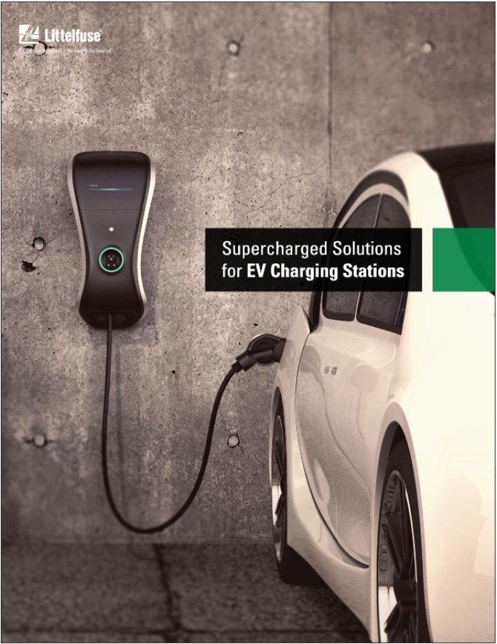
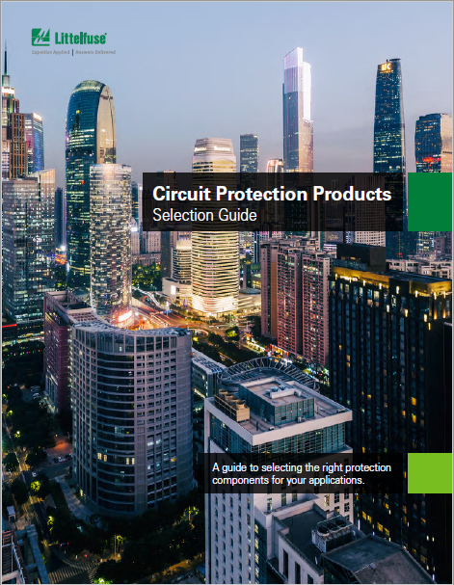
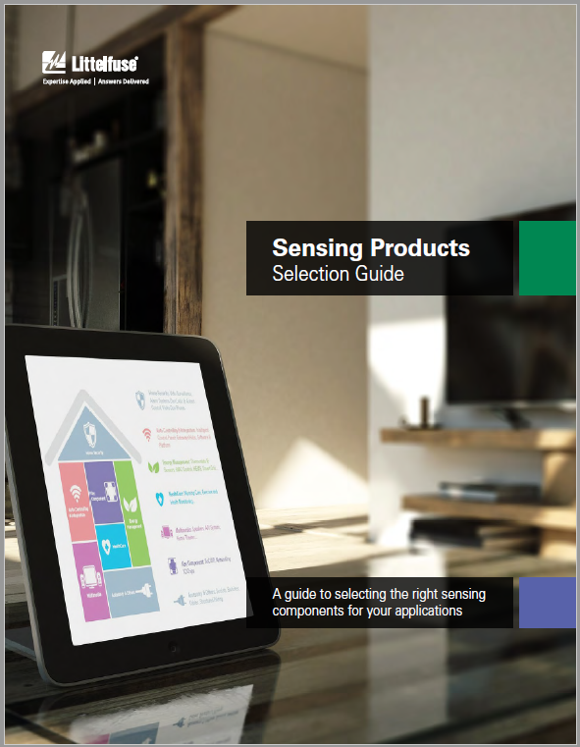
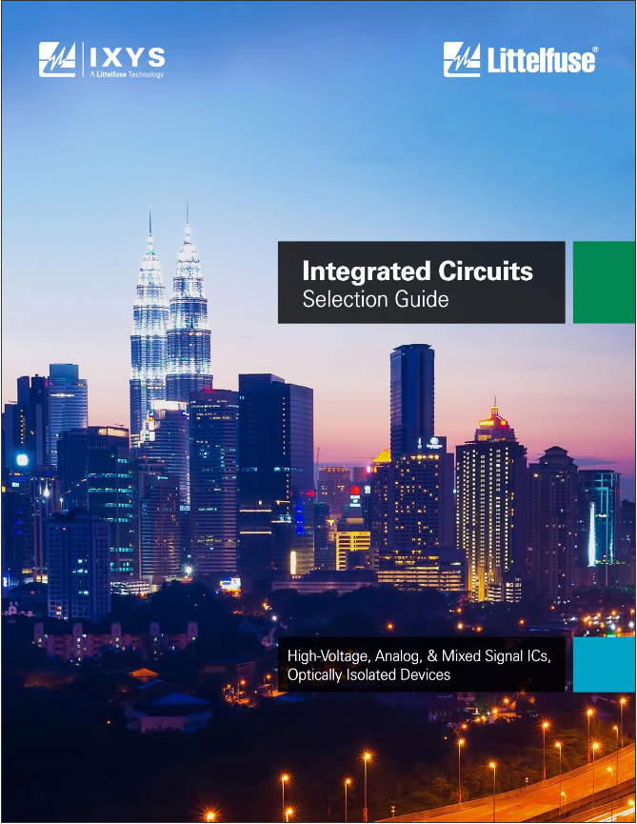
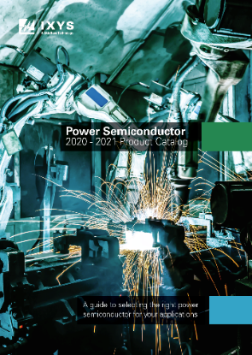
Additional information can be found on Littelfuse.com Explore the world of Littelfuse with the electronics eCatalogs (electronicscatalogs.littelfuse.com)
EV Charging Application Guide
Circuit Protection
Selection Guide
Sensing Products
Selection Guide
Integrated Circuits
Selection Guide
Click on images for more information
Power Semiconductor Catalog
Two-/Three-Wheeler Solutions Spotlight

Slide 11
Local resources supporting our global customers
Bremerhaven
Bremen
Lampertheim
Essen
Lauf
Leiden
Chicago
Mount Prospect
Madison
Rock Falls
Troy
Champaign
Beijing
Wuxi
Suzhou
Shanghai
Kunshan
Amsterdam
Deventer
Saskatoon
Chippenham
Exeter
Kaunas
Legnago
Lons-le-Saunier
Zhongshan
Shenzhen
Dongguan
Hong Kong
Huizhou
Tsukuba
Tokyo
Kanagawa
Rapid City
Meridian
Beverly
Plainville
Waltham
Dole
Seoul
Seongnam
Fremont
Milpitas
Long Beach
Round Rock
Jupiter
Allen
San Sebastian
Charneca de Caparica
Taipei
New Delhi
Kanpur
Hsinchu
Brownsville
Piedras Negras
Hermosillo
Matamoros
Matehuala
Muzquiz
Taguig
Lipa City
Singapore
Hung Yen
Manaus
São Paulo
Legend
Sales
R&D
Manufacturing

Slide 12
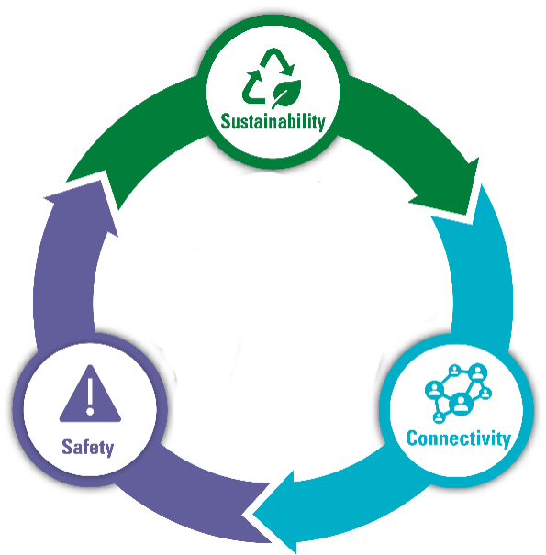
Partner for tomorrow’s electronic systems
BROAD
PRODUCT PORTFOLIO
COMPLIANCE AND
REGULATORY EXPERTISE
An industrial technology manufacturing company empowering a sustainable, connected, and safer world
To help customers in the design process to account for requirements set by global regulatory authorities
APPLICATION
EXPERTISE
TESTING
CAPABILITIES
Our engineers partner directly with customers to help speed up product design and meet their unique needs
To help customers get products to market faster, we offer certification testing for global regulatory standards
GLOBAL
CUSTOMER SERVICE
GLOBAL
MANUFACTURING
Our global customer service team is with you to anticipate your needs and ensure a seamless experience
High-volume manufacturing that is committed to the highest quality standards

Slide 13
Littelfuse.com
This document is provided by Littelfuse, Inc. (“Littelfuse”) for informational and guideline purposes only. Littelfuse assumes no liability for errors or omissions in this document or for any of the information contained herein. Information is provided on an “as is” and “with all faults” basis for evaluation purposes only. Applications described are for illustrative purposes only, and Littelfuse makes no representation that such applications will be suitable for the customer’s specific use without further testing or modification. Littelfuse expressly disclaims all warranties, whether express, implied, or statutory, including but not limited to the implied warranties of merchantability and fitness for a particular purpose and non-infringement. It is the customer’s sole responsibility to determine suitability for a particular system or use based on their own performance criteria, conditions, specific application, compatibility with other components, and environmental conditions. Customers must independently provide appropriate design and operating safeguards to minimize any risks associated with their applications and products. Read complete Disclaimer Notice at: www.littelfuse.com/disclaimer-electronics.

